Slide 1
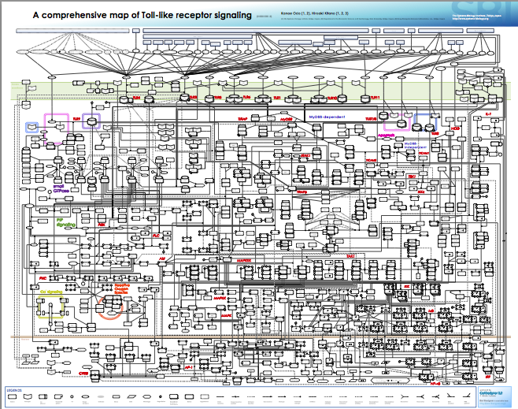
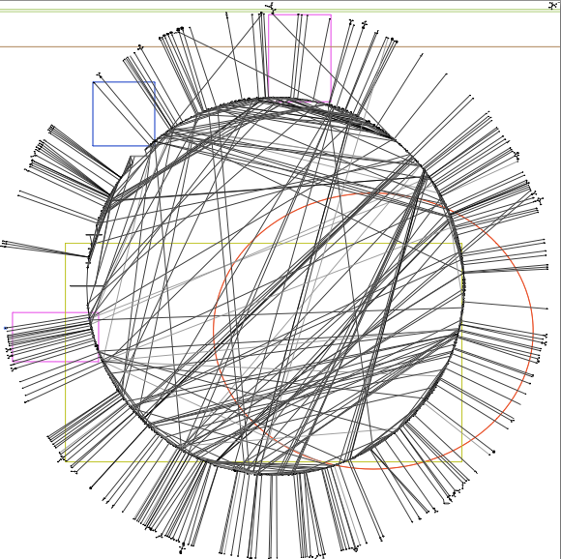
Innate immune signaling network are complex
TLRs: 11
No of species: 652
No of edges: 444

Slide 2

But we can find features from these complex network
-- double bow-tie
Notes:
http://www.nature.com/ni/journal/v4/n12/fig_tab/ni1203-1162_F1.html
Key node.

Slide 3
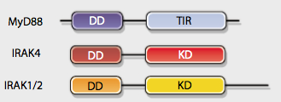
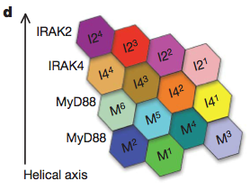
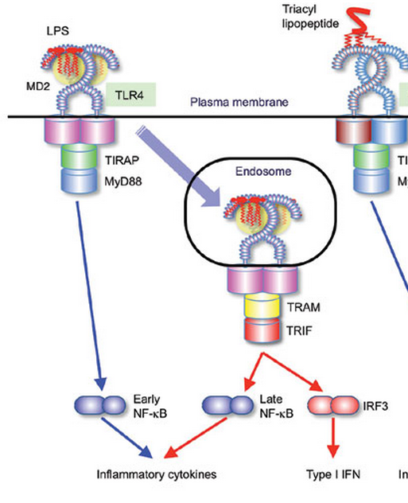
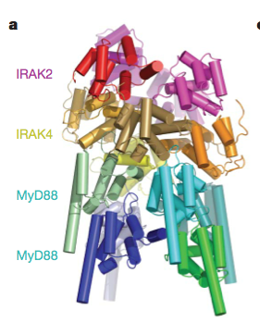
TLR4 is special
Dynamical features in the sub-pathways (quantitatively)
Molecular details in shaping the dynamics
Notes:
Single cells and population: Gave more fundamental molecular mechanism.
Auto/para-crine feedback via TNF (limited to MEFs).
First 4 hours at most.

Slide 4
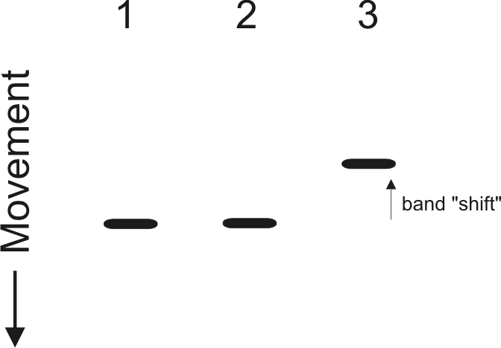
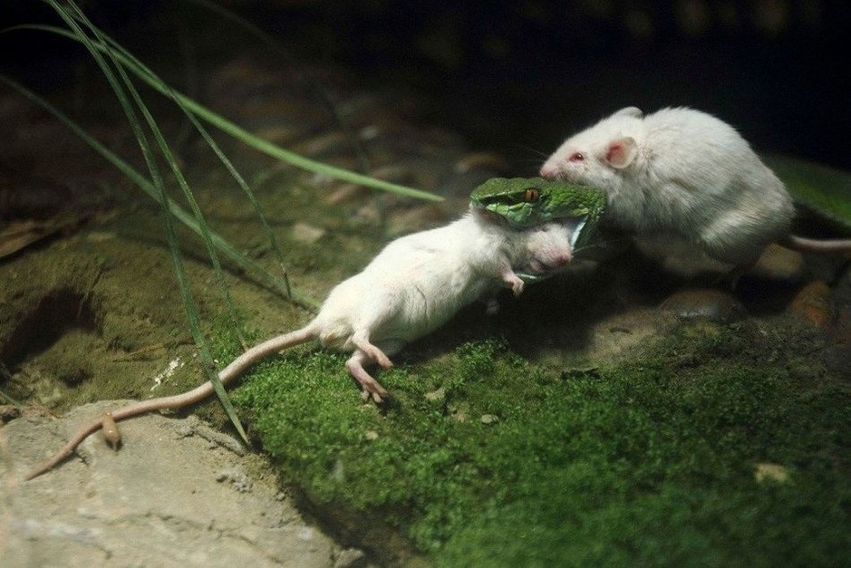

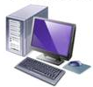
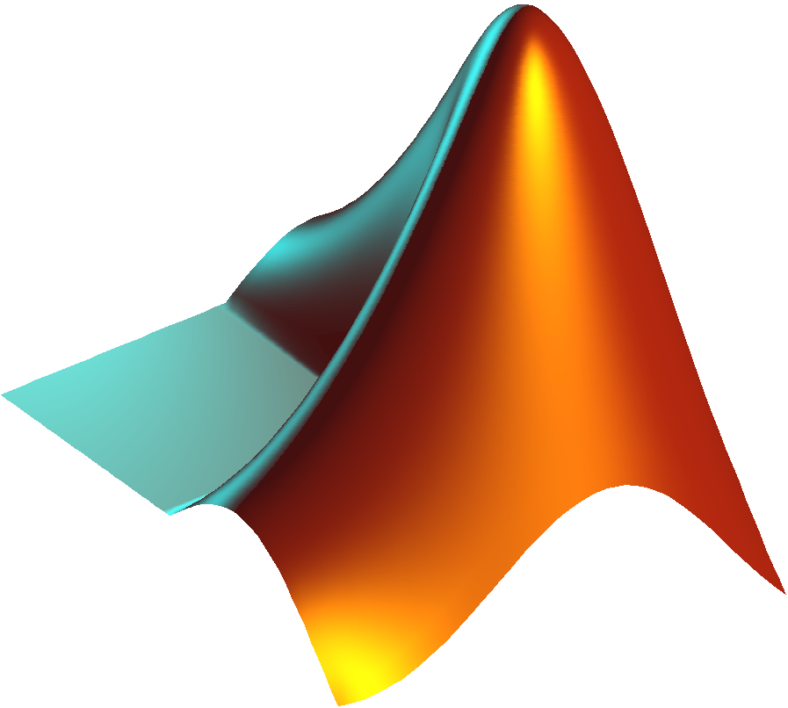
Method
Electrophoretic mobility shift assay
Kinase assay
Gene knockout mouse
Computational modeling

Slide 5
The TLR4 model diagram
3 compartments
41 species
100 Reactions
Notes:
Need reaction maps.

Slide 6
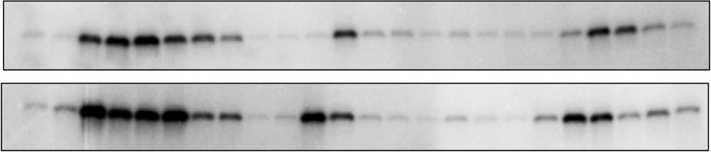
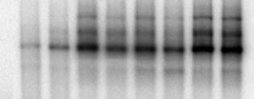
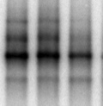
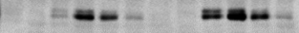
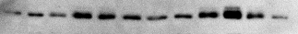
Model validation and experimental data
B
WT
trif ^{- /-}
myd88^{- / -}
LPS
15
120
120
120
min
30
45
60
90
15
30
45
60
90
15
30
45
60
0
90
5
0
5
0
5
1 ng/ml
IKK
100ng/ml
1 ng/ml LPS
100 ng/ml LPS
120
min
240
120
10
30
60
10
240
0
30
60
NFκB_{n}
1 ng/ml LPS
100 ng/ml LPS
0
10
30
60
120
240
0
10
30
60
120
240
min
IRF3_{np}
IRF3_{n}
C
D
IKK
NFκBn
0.8
wt exp.
0.8
wt sim.
0.4
0.4
0
0
20
40
60
80
100
120
0
Level (Normalized to maximum)
Level (Normalized to maximum)
Time (min)
0
30
60
90
120
150
180
210
240
0.6
IRF3_{np}
0.8
wt exp.
0.4
wt sim.
0.2
0.4
0
0
20
40
60
80
100
120
0
0
30
60
90
120
150
180
210
240
Time (min)
Time (min)
Red: 100 ng/ml LPS; Blue: 1 ng/ml LPS
Red: 100 ng/ml LPS; Blue: 1 ng/ml LPS
wt exp.
wt sim.
mko exp.
mko sim.
tko exp.
tko sim.
With Diana
Notes:
Always to question about how big your parameter space is. And how robustness about the parameter set.

Slide 8
Dynamics features in sub-pathways: duration, responsive speed
A
B
Both
TRIF pathway
MyD88 pathway
Similar response slope
10²
C
D
Overlap response speed
Notes:
Similar response slop

Slide 9
Myddosome formation produce kinetic threshold in signaling activation
Input
Output
MyDDosome model
dM/dt <- -2*k1*C*M + 2*k_1*CM2 + 6*kd*M6
dC/dt <- k_1*CM2-k1*C*M + 3*k4*C3M6
dCM2/dt <- k1*C*M - k_1*CM2- 2*k2*CM2^2- k3*CM2*C2M4
dC2M4/dt <- k2*CM2^2- k3*CM2*C2M4
dC3M6/dt <- k3*C2M4*CM2 - k4*C3M6
dM6/dt <- k4*C3M6 – k5*M6
k1=kf,k_1=kb,k2=kf,k3=kf,k4=kf,k5=kb
kf=1,kb=0.1
M0=10,C0=from 0 to 10
Notes:
Input

Slide 10
Myddosome formation produce kinetic threshold in signaling activation
A
0.8
0.6
6*M^{ss}₆/M₀
0.4
0.2
Threshold
0
M^{ss}₆/M₀
C
B
10
0.8
8
3.2
0.6
3
6
2.8
k_{f}/k_{b}
0.4
Hill coefficient (n)
2.6
4
2.4
2
0.2
2.2
2
1
0
0.2
0.4
0.6
0.8
0
0
k_{f} /k_{b}
0
0.2
0.4
0.6
0.8
1
C₀/M₀
Notes:
Input

Slide 11
The kinetic threshold produce the threshold in the first peak
n = 3.2
n = 2

Slide 12
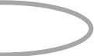
From cell population to single cell.
Before clustering
After clustering
B
NFκBn
C
NFκBn
1
1
1
1
50
0.8
50
LPS 1
0.8
A
0.6
0.6
100
100
f_{m}
0.4
0.4
150
150
LPS 2
MyD88
MyD88*
0.2
0.2
200
0
200
0
0
60
120
180
240
0
60
120
180
240
D
Time (min)
E
Time (min)
f_{t}
1
LPS 1
1
LPS 2
TRIF
TRIF*
Activation efficiency
Activation efficiency
0.5
0.5
0
0
MyD88 pathway
(f_{m})
TRIF pathway
(f_{t})
MyD88 pathway
(f_{m})
TRIF pathway
(f_{t})
LPS 1 need little Trif activation
Notes:
Randomize this figure.

Slide 13
Stochastic activation in Trif alone can generate two clusters
But but the stochasticity in MyD88 will bring in viability in response speed.

Slide 14
Conclusions:
Dynamical features in the sub-pathways (quantitatively):
MyD88 sub-pathway determine the response speed (linearly to log dose).
TRIF sub-pathway determine the response duration(linearly to log dose).
Molecular details in shaping the dynamics:
Myddosome formation produce threshold in signaling activation
The ligand induced-shuttling is responsible for the duration specificity
Stochasticity happens at the level of sub-pathway activation can explain single cell data
Stochastic activation in Trif alone can generate two clusters
But the stochasticity in MyD88 will bring in viability in response speed.
Notes:
Conclusions:

